Slide 1
RELATIVE DATING PICTURES

Slide 2
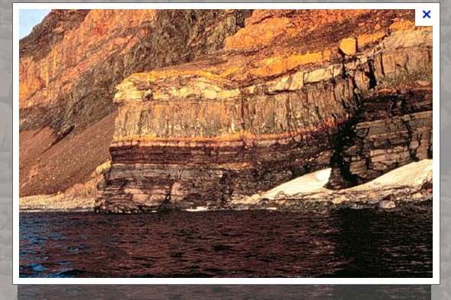

Slide 3
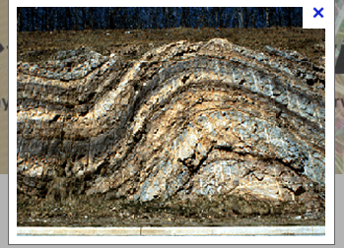
FOLDING ROCK LAYERS

Slide 4
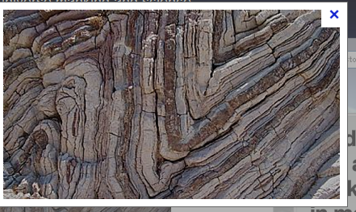

Slide 5
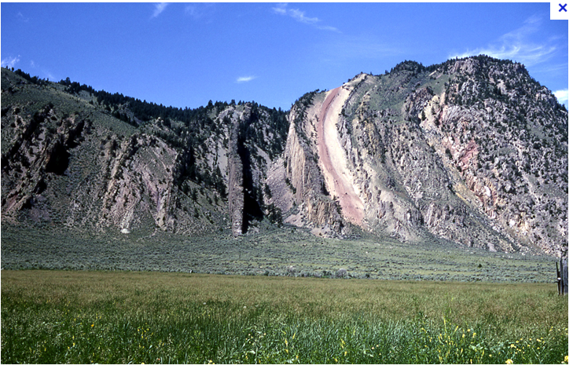
TILTING ROCK LAYERS

Slide 6
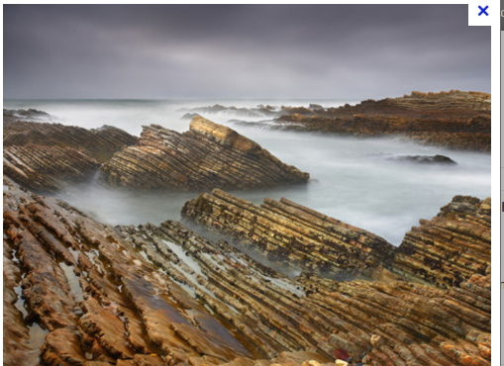

Slide 7
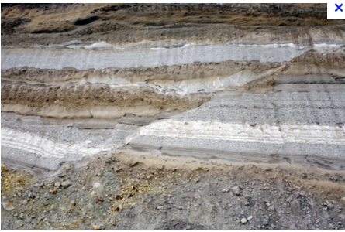
FAULT

Slide 8
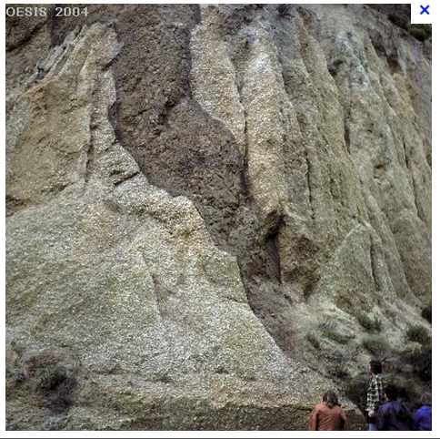
INTRUSION LAYERS

