Slide 1
Light & the Electromagnetic Spectrum Notes

Slide 2
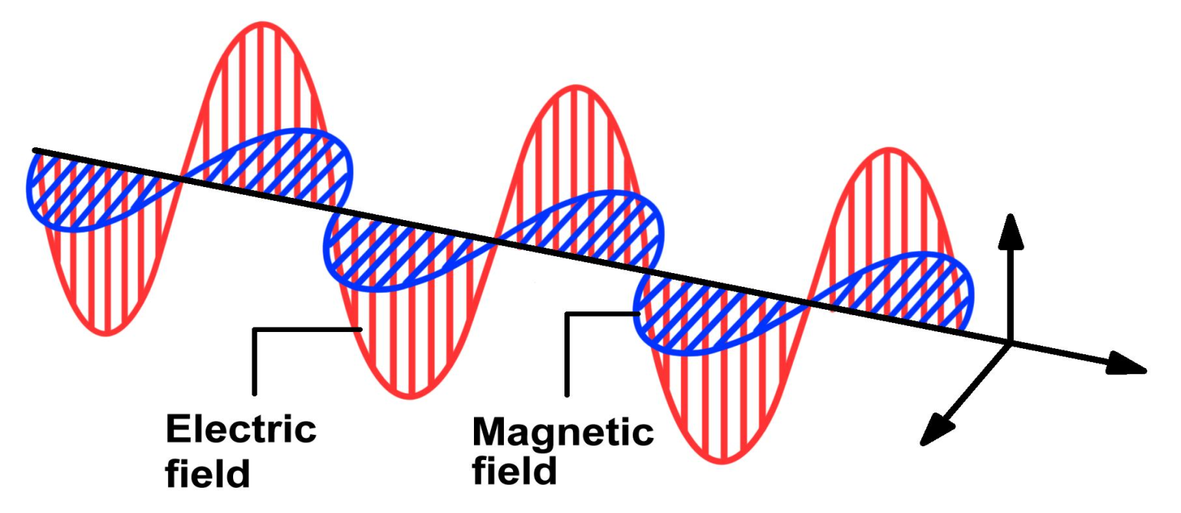
1. Light
Light is a form of ______ that travels as an electromagnetic wave.
Electromagnetic waves are made of _______ and _________ fields.
EM waves can travel through ______ ______ and ______.
energy
electric
magnetic
empty
space
matter

Slide 3
straight
Light travels in a _______ line.
Draw light leaving a source: use straight ____ with ______ at end to show ________ light is traveling.
line
arrow
direction
*Draw light rays leaving a source

Slide 4
emitted
Light is _______ from a light source (light bulb, sun, flame, etc).
Emit: to _____ forth/out from (a light source).
send
*Light bulb emits light into your eye

Slide 5
Quick Quiz
Light is a form of ______ that travels as an electromagnetic wave.
A. brightness
B. energy
C. matter
D. space

Slide 6
Quick Quiz
Light travels in a _______ line
A. curved
B. angled
C. straight
D. circular

Slide 7
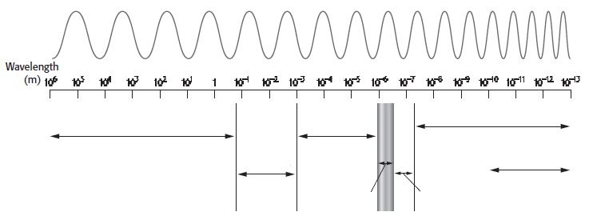
2. Electromagnetic Spectrum
Electromagnetic Spectrum is the entire _____ of all the ______________ waves.
range
electromagnetic
infrared waves
X-rays
radio waves
micro-waves
gamma rays
visible light
UV light

Slide 8
Radio waves
___________: longest wavelength, lowest frequency, lowest energy, _______ sources.
___________: shortest wavelength, highest frequency, highest energy, _______ sources.
coolest
Gamma rays
hottest

Slide 9
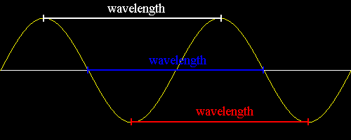
3. Wavelength and Frequency
waves
All ______ have both a frequency and a wavelength.
___________: is the distance between the tops or crests of two waves. (draw this & label)
wavelength

Slide 10
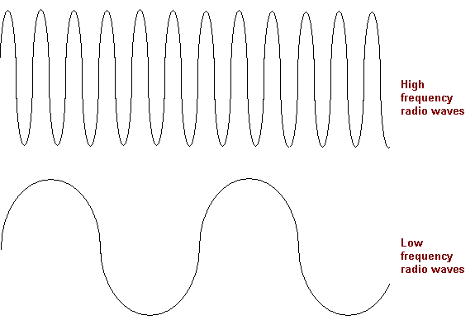
Frequency
_________: the number of waves that pass a point in one second.
The more crests that pass a point in 1 second, the ______ the frequency.
higher
Draw both waves & label
higher frequency
lower frequency
Click Me
What is the frequency in the example below?
0 sec.
1 sec.
Answer: 3

Slide 11
4. Visible Light
small
Very _____ part of electromagnetic spectrum you ____ ____.
Energy from the ___ reaches Earth as _____ light. It is a _______ of all ______ of light.
can
see
sun
white
mixture
colors

Slide 12
White light can be divided into _____ according to __________.
Can use a _____ to split white light into different wavelengths.
colors
wavelength
prism
*draw light entering prism and the different colors coming out

Slide 13
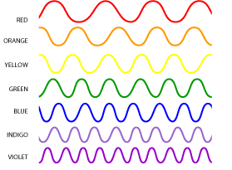
unique
Each color has a ______ wavelength.
R: ________________
O: _________________
Y: ________________
G: ________________
B: ________________
I: ________________
V: ________________
red ~630-700nm
orange ~590-630nm
yellow ~560-590nm
green ~490-560nm
blue ~440-490nm
indigo ~420-440nm
violet ~400-420nm

Slide 14
5. Infrared Waves
700
1
Range from ____nm to __mm.
______ wavelength than ______ light.
______ the Earth & keeps temperature suitable for life.
Longer
visible
Warms

Slide 15
6. Ultraviolet Light
60
400
Range from ___nm to ____nm.
_______ wavelength than ______ light.
Shorter
visible

Slide 16
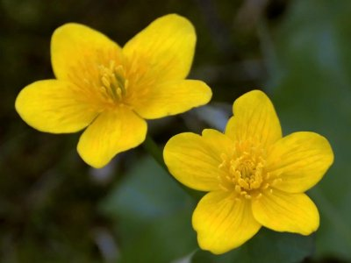
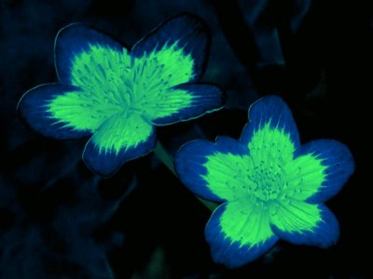
bees
see
Some animals like _____ can ____ ___ (ultraviolet) light.
UV
what we see
what a bee sees

Slide 17
Quick Quiz
Visible light is _____ of the electromagnetic spectrum that you can see.
A. a large part
B. most
C. not a part
D. a very small part

Slide 18
Quick Quiz
Which one shows where visible light is located on the electromagnetic spectrum?
B
A
D
C

Slide 19
Quick Quiz
Bees can see shorter wavelengths of light than visible light. They can see __________.
A. x-rays
B. gamma rays
C. infrared
D. ultraviolet light

