Slide 1
Lever Flash
Cards

Slide 2
Directions
Add the label/info to the front of the flashcard for each level of organization.
The second slide has the notes you will write on the back of the flashcard.
Make sure you use bullets and that you write the notes exactly as they are given.

Slide 3
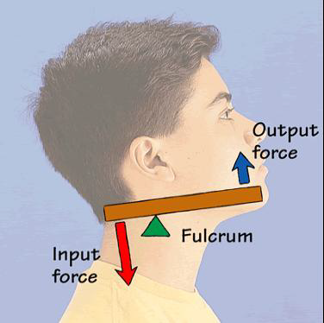
1st Class Lever

Slide 4
1st Class Lever
The fulcrum is somewhere between the force and the load.
Adds more force (advantage) depending on where the fulcrum is placed.

Slide 5
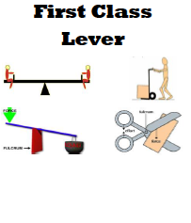

Slide 6
First Class Lever
Examples: Your skull on the top of the spine, see-saws, scissors, crowbars, and your arms during a pushup.

Slide 7
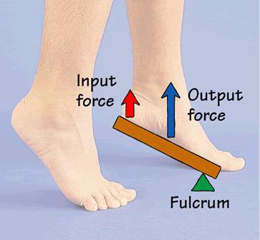
2nd Class Lever

Slide 8
2nd Class Lever
The load is somewhere between the fulcrum and the force.
Adds more force (advantage).

Slide 9
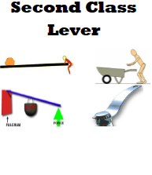

Slide 10
Second Class Lever
Very few examples of these in the body.
Examples: Your foot when you stand on your toes, wheelbarrows, bottle openers, and your whole body during a pushup.

Slide 11
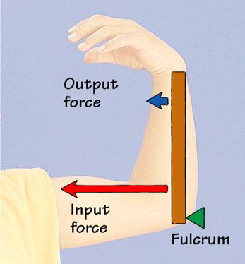
3rd Class Lever

Slide 12
Third Class Lever
The force is somewhere between the fulcrum and the load.
Increases movement speed.
Force is NOT increased.

Slide 13
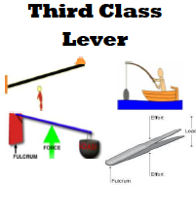

Slide 14
Third Class Lever
Examples: Your arm when you lift a book, tweezers, a baseball bat hitting a ball, a fishing pole, and your upper body during a sit up.

