Slide 1
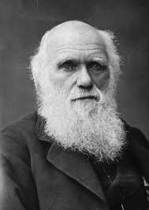
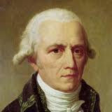
Theory of Evolution: Darwin vs. Lamarck

Slide 2
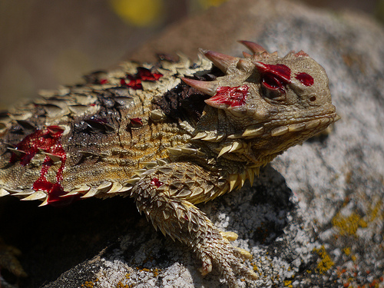
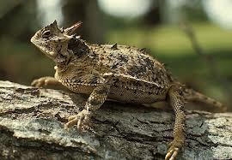
Texas Horned Lizard
Defense Behavior Adaptations
Its horns are extensions of its cranium and contain true bone.
When threatened it will puff up its body to cause its spiny scales to protrude, which makes it hard to swallow.
Has the ability to squirt an aimed stream of blood from the corners of it’s eyes and sometimes mouth for a distance up to 5 feet.

Slide 3
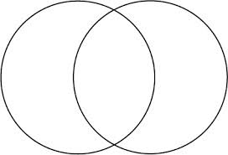
Objective
Students will be able to identify three scenarios of Darwin and Lamarck’s theory of evolution on a worksheet provided in class.
Venn Diagram
Same
Different
Different

Slide 4
Who is Darwin and Lamarck?
Charles Darwin
Jean-Baptiste Lamarck
Feb. 1809-April 1882
English Naturalist.
Published his theory of evolution in his book On the Origin of Species.
Remembered for his theory of evolution called natural selection.
Aug. 1744-Dec. 1829
French Naturalist.
Provided the first truly cohesive theory of evolution.
Remembered for his use/disuse theory of evolution.

Slide 5
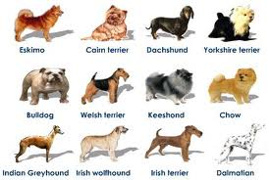
Darwin’s Theory of Evolution
Organisms that have variation will adapt to their environment and have more offspring.
Offspring are born with their parents’ favorable traits and as they reproduce those traits become more dominant.
Inheritance
Variation

Slide 6
Lamarck’s Theory of Evolution
Changes in an organism are influenced by what the organism wants or needs and then over many generations the offspring are born with these changes.
Individual structures (body parts) of an organism decreases in size by disuse and increases in size when used.
Wants and Needs
Use and Disuse

Slide 7
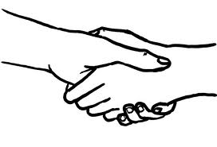
Darwin and Lamarck agreed that…
Organisms change to work better in their environment.
Organisms have evolved (changed) over time and are still evolving.

